Slide 1
Comparable vs Comparator

Slide 2
Agenda
1. Why do we need Comparable & Comparator?
2. Comparable Interface — Deep Dive
3. Comparator Interface — Deep Dive
4. Comparable vs Comparator — Head-to-Head
5. Live Code Demo
6. Java 8+ Enhancements
7. Q&A

Slide 3
Problem ?
How does Java know how to sort YOUR custom objects?
List<String> names = Arrays.asList("Charlie", "Alice", "Bob");
Collections.sort(names); // ✅ Works! (String implements Comparable)
List<Employee> employees = getEmployees();
Collections.sort(employees); // ❌ How to sort? By name? salary? age?
💡 Answer: Comparable & Comparator define the SORTING LOGIC

Slide 4
Comparable Interface
Comparable<T> Interface
Package: java.lang
📝 Method: int compareTo(T o)
🔑 Key Characteristics:
• Defines the NATURAL ordering of objects
• Class itself implements the interface
• Only ONE sorting sequence possible
• Used by: Collections.sort(), Arrays.sort(), TreeSet, TreeMap
📐 Contract:
│ Returns NEGATIVE → this < other │
│ Returns ZERO → this == other │
│ Returns POSITIVE → this > other │
💬 Think of it as: "I know how to compare MYSELF with others"

Slide 5
Let’s go to practical example

Slide 6
Comparator Interface
Comparator<T> Interface
📦 Package: java.util
📝 Method: int compare(T o1, T o2)
🔑 Key Characteristics:
• Defines CUSTOM/EXTERNAL ordering
• Separate class implements the interface (or lambda)
• MULTIPLE sorting sequences possible
• Does NOT modify the original class
• Used by: Collections.sort(list, comparator),
list.sort(comparator), TreeSet, TreeMap
📐 Contract:
│ Returns NEGATIVE → o1 < o2
│ Returns ZERO → o1 == o2
│ Returns POSITIVE → o1 > o2
💬 Think of it as: "A third-party judge decides the order"

Slide 7
Let’s go to practical example

Slide 8
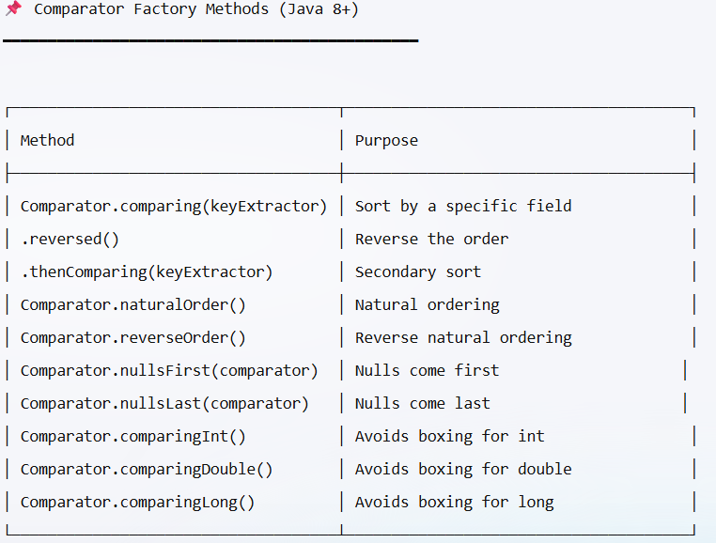
Comparator — Java 8+ Utility Methods

Slide 9
Q&A

